Slide 1
F.Y. B.Com. Sem-II
Mathematical & Statistical Techniques
Remedial Lecture
25th February 2020
9.00 a.m. to 10.30. a.m.
by
Amitha M Rao

Slide 2
University of Mumbai
F.Y. B.Com. Sem-II
Mathematical & Statistical Techniques
Examination Paper Pattern

Slide 3
Syllabus
Section-I
Mathematics
Section-II
Statistics

Slide 4
Section-I:Mathematics(40 Mks)
There will be 2 questions of 20 marks each.
Each main question has 5 sub questions of 5 marks each
Students have to attempt any 4 out of 5 subquestions
Question 1:Unit-I
Derivatives & Applications
Question 2:Unit-II
Interest and Annuity

Slide 5
Section-II:Statistics(60 Mks)
There will be 3 questions of 20 marks each.
Each main question has 5 sub questions of 5 marks each
Students have to attempt any 4 out of 5 subquestions
Question 3:Unit-III
Correlation
Question 4:Unit-IV
Time Series and Index Numbers
Question 5:Unit-V
Probability Distribution

Slide 6
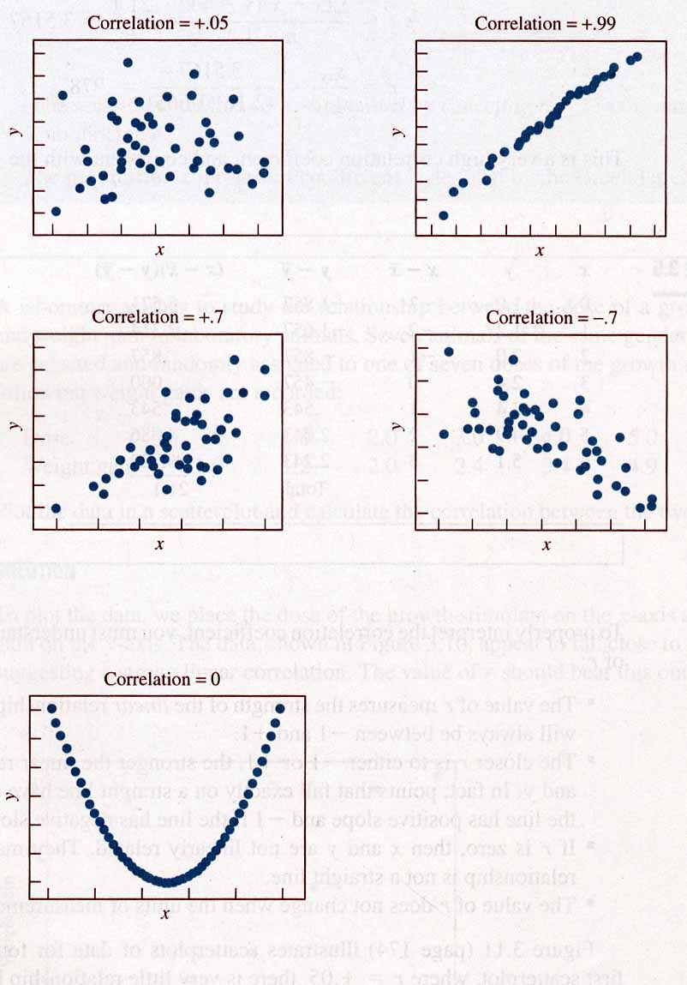
Scatter Diagrams
Scatter diagrams are used to demonstrate
correlation between two quantitative variables.
  A scatter diagram shows at a glance the direction of the relationship.

Slide 7
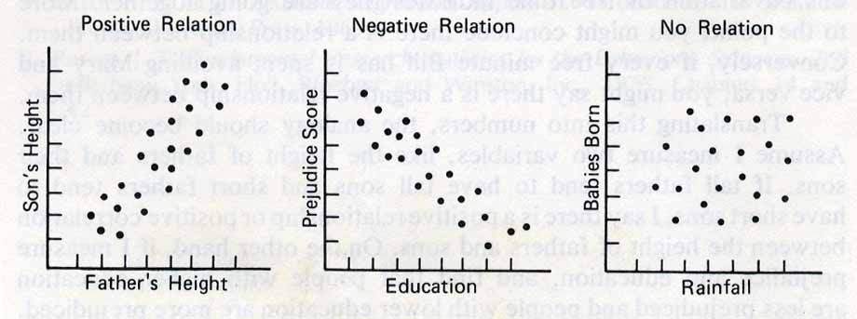
Positive Correlation( +)
  A positive correlation appears as a cluster of data points that slopes from the lower left to the upper right.

Slide 8
Negative Correlation( -)
  A negative correlation appears as a cluster of data points that slopes from the upper left to the lower right.

Slide 9
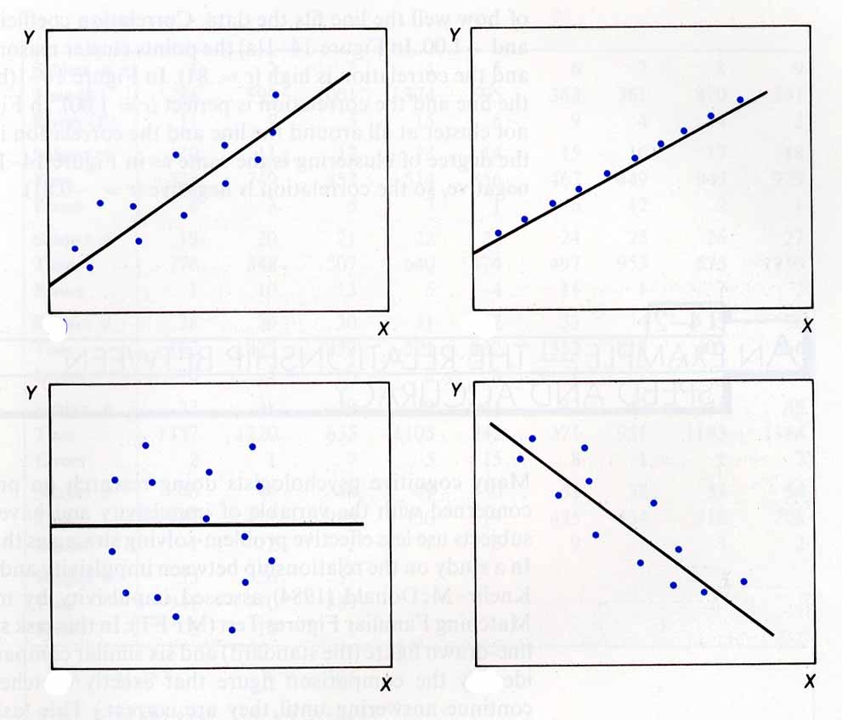
No Correlation
In cases where there is no correlation between two variables, there is no direction in the pattern of the dots.
They are scattered about the plot in an irregular pattern.

Slide 10
Strength of Relationship
How can we describe the strength of the
relationship?
A number between -1 and +1 that indicates the relationship between two variables.
The sign (- or +) indicates the direction of the relationship.
The number indicates the strength of the relationship.

Slide 11
Time-Series Components
When Quantitative data is arranged in the order of their occurrence or historical order or chronological order, the resulting statistical series is ‘Time Series’
Secular Trend
Cyclical
Time-Series
Random
(Irregular)
Seasonal

Slide 12
Secular Trend Component
Overall Upward or Downward Movement
Data Taken Over a Period of Years
Long term movement of the data
Sales
Upward trend
Time

Slide 13
Cyclical Component
Upward or Downward Swings
May Vary in Length
Usually Lasts 2 - 10 Years
Sales
Cycle
Time

Slide 14
Seasonal Component
Upward or Downward Swings
Regular Patterns
Observed Within 1 Year
Winter
Sales
Time (Monthly or Quarterly)

Slide 15
Random or Irregular Component
Erratic, Nonsystematic, Random, ‘Residual’ Fluctuations
Due to Random Variations of
  Nature
  Accidents
Short Duration and Non-repeating

Slide 16
Moving Average Example Solution
Year Response Moving Avg
1994 2 NA
1995 5 3
1996 2 3
1997 2 3.67
1998 7 5
1999 6 NA
Sales
8
6
4
2
0
94 95 96 97 98 99

Slide 17

























































































































































Fit a trend line by least square method
Year(x) | Value(y)
2000 2001 | 12 20
2002 | 34
2003 | 26
2004 | 45
2005 | 56
2006 | 70

